Slide 1
إدارة المشروعات الهندسية الفصل الخامس: هات 213 Engineering Project Management

Slide 2
The Project Organization
The Project Manager (PM) is shown at the top of the chart with two other key players, the Chief Systems Engineer (CSE) and the Project Controller (PC).
The below chart shows only the project and not the organization in which the project may be embedded.
Some project may have larger and include additional functions such as manufacturing, production engineering, installation, operations and maintenance, and others

Slide 3
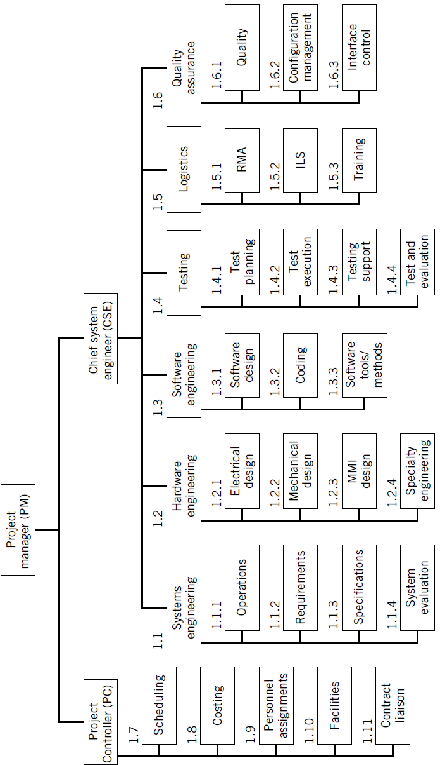
Illustrative project organization. RMA reliability-maintainability-availability; ILS integrated logistics support; MMI man-machine interface.

Slide 4
Responsibilities of Project Manager?
Cost/Budget
Confirming that the project can be completed within budget
Reviewing periodic (e.g., monthly) cost reports
Obtaining valid cost-to-complete estimates
Assessing and mitigating project cost risks
Assuring the validity of system life-cycle costs
Schedule
Establishing an up-to-date master schedule
Assuring that all interim milestones are met
Determining ways to make up time when slippage occurs
Obtaining valid time-to-complete estimates
Scheduling internal and customer status reviews

Slide 5
Technical Performance
Assuring that the system satisfies all technical requirements
Confirming the validity of the technical approach
Continuous tracking of technical performance status
Installing systems and software engineering methods/practices
Obtaining computer tools for systems and software engineering
Administrative
Personnel interviewing, hiring, and evaluation
Interfacing with corporate management
Interfacing with internal project support groups
Coaching and team building
Assuring the availability of required facilities

Slide 6
Responsibilities of Chief System Engineer?
Establish the overall technical approach
Evaluate alternative architectural system designs
Develop the preferred system architecture
Implement a repeatable systems engineering process
Implement a repeatable software engineering process
Oversee use of computer tools and aids
Serve as technical coach and team builder
Hold technical review sessions
Attempt to minimize overall project time period
Develop cost-effective system that satisfies requirements

Slide 7
Responsibilities of Project Controller
Maintain overall project schedule
Assess project schedule risks
Assure validity and timeliness of project cost reports
Track special cost items (e.g., travel, subcontractors)
Develop project cost trends
Assess project cost risks
Maintain life-cycle cost model for system
Verify and maintain personnel assignments
Assure that necessary facilities are available
Maintain appropriate liaison with contracts department

Slide 8
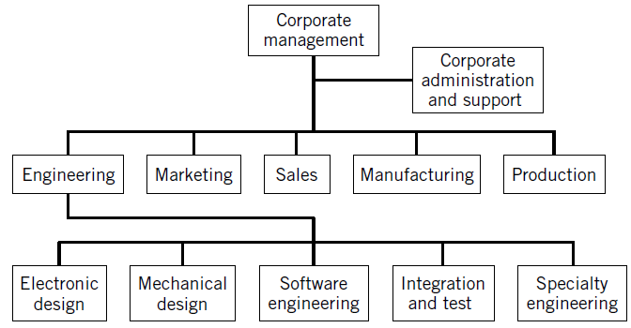
Corporate Organizational Structures
There are three generic types of corporate structures: the functional structure

Slide 9
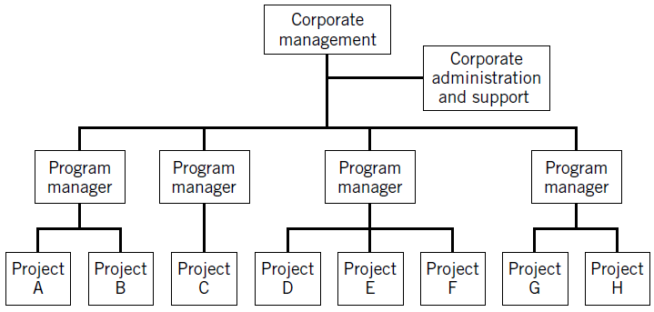
The project structure:

Slide 10
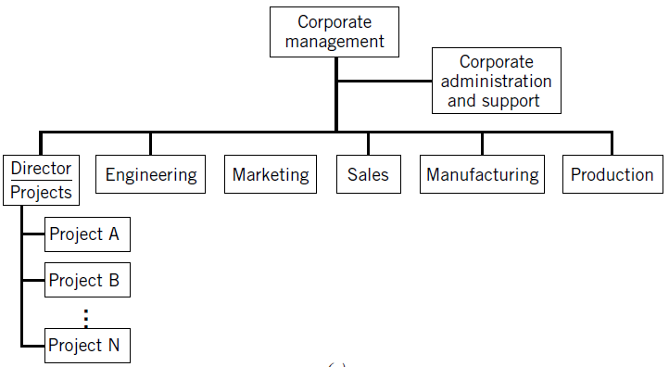
The Matrix structure:

